Slide 1

Two pieces of bread
Want to present you their idea

Slide 2


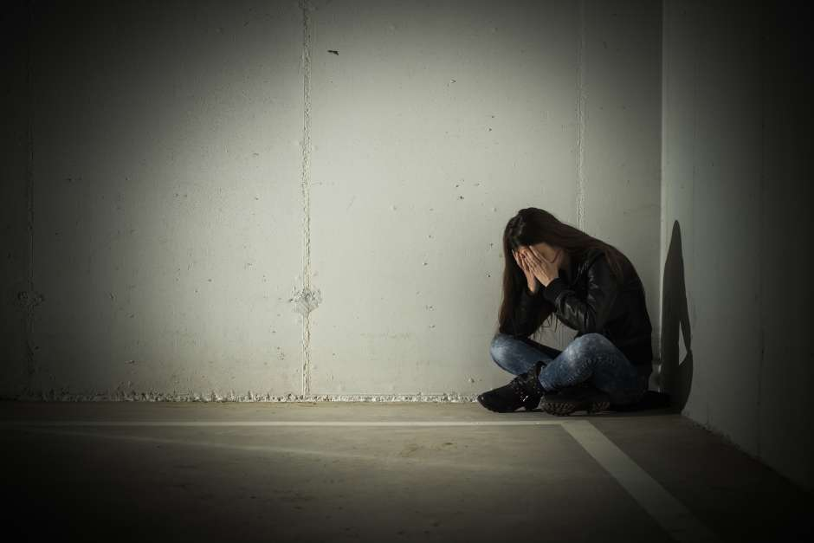
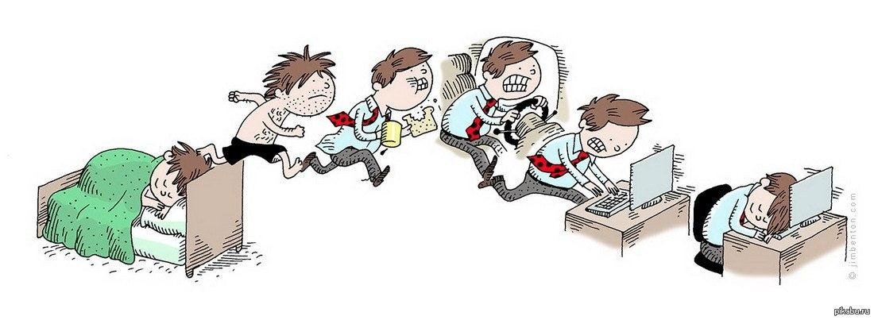
Idea

Slide 3


Our web page
Social comfort for all people

Slide 4









To make this project we used

Slide 5

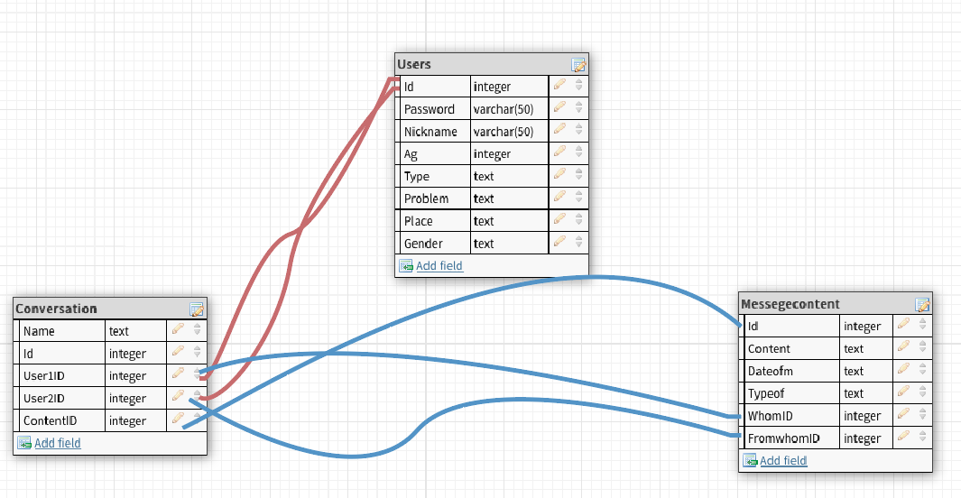
Our databases

Slide 6



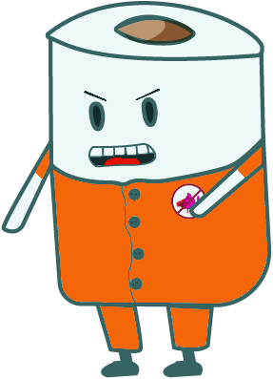
Game

Slide 7



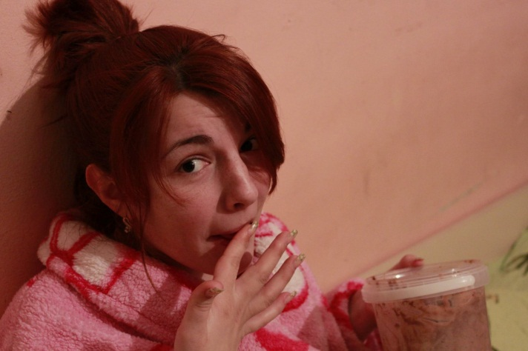



Thank you for your help

Slide 8
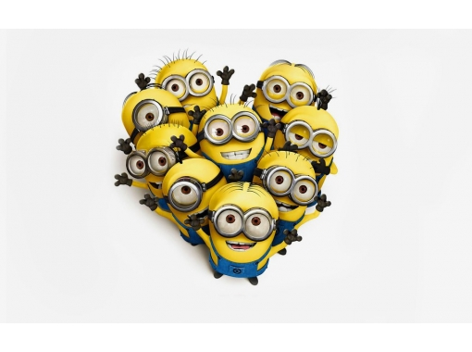
Thank you for your attention

